Slide 1




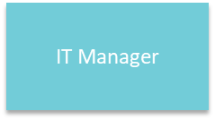
Managing Director
Publications & Advocacy Director
Accredited Representative to IMO
HR Consultancy
General Counsel & Business Support Director
Governance & Performance Manager
Programmes Director
Risk & Regulatory Affairs Adviser
Publishing &
Communications
Manager
Quality Assurance Manager
Programmes Contracts
Manager
Senior
IT Manager
Office Manager
Engineering Adviser
Administration Officer (Publications & Advocacy)
Programmes Quality Assessors
Inspector Training & Accreditation Manager
Editor
Offshore Adviser
Administration Officer (Programmes)
Training & Accreditation Administrator
Management Accountant
Environmental Adviser
Technical Project Manager – VIP Project
Barge Adviser
Accounts & HR Administrator
Training & Accreditation Administrator
Security Adviser
VIP Resources
12-24 months
Nautical Adviser

